Slide 1
Global Fusion POS: An Automated Computational Engine for Modern Hospitality
Core Technology: Developed using Python 3.12 for high-speed transaction processing.
Industry Focus: Specialized for the F&B (Food & Beverage) Fusion sector.
Presenter: Panchami Chakraborty |VIT BHOPAL
Subtitle: Bridging the gap between manual billing and complex ERP software

Slide 2
Project Vision & Scope
.
Efficiency First: Reducing the "time-to-table" for billing from minutes to seconds.
Accuracy: Eliminating human error in tax and service charge calculations.
Accessibility: A lightweight CLI interface that runs on any operating system.
Customization: A modular menu system that adapts to seasonal food changes.
Financial Integrity: Ensuring every discount and tax is applied consistently.

Slide 3
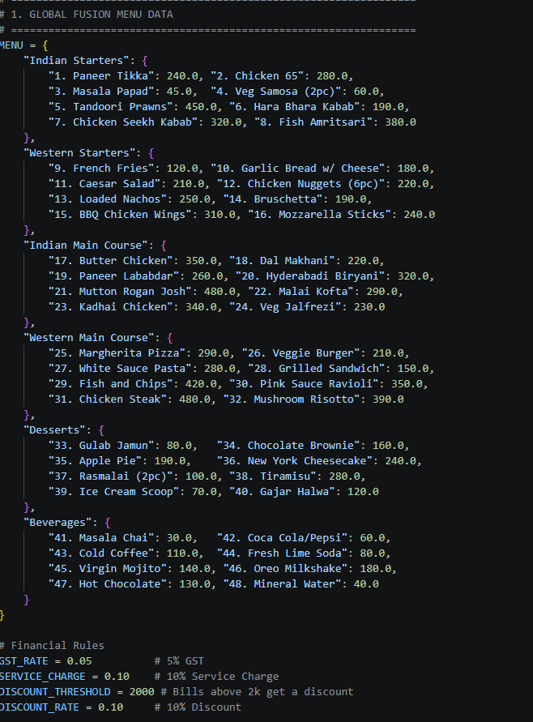
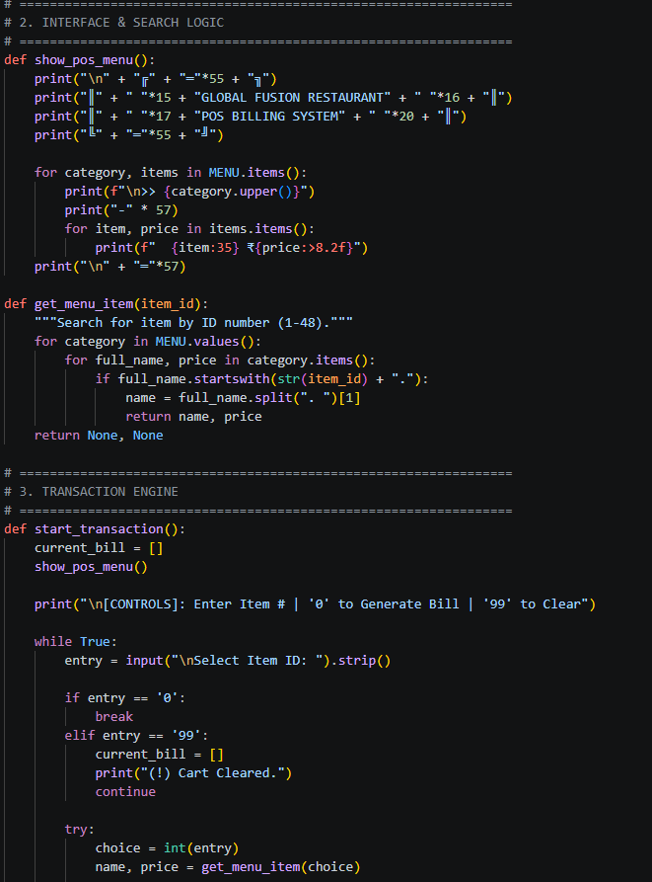
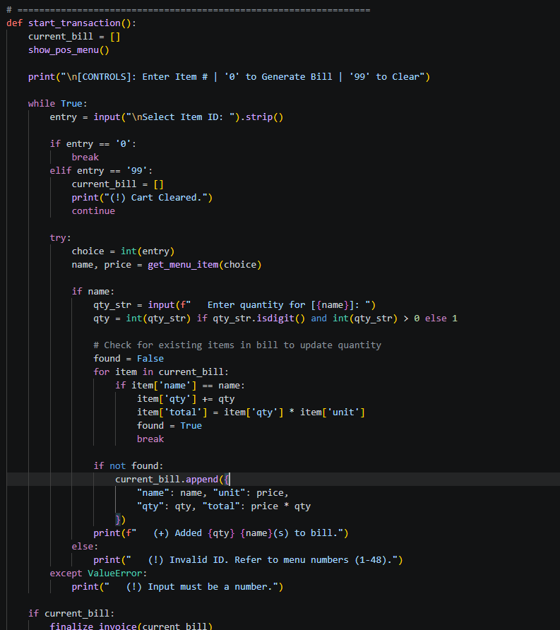
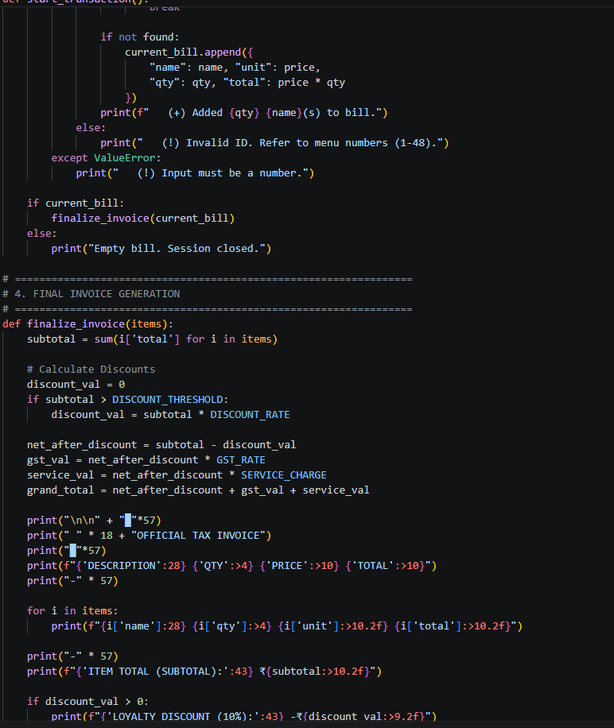
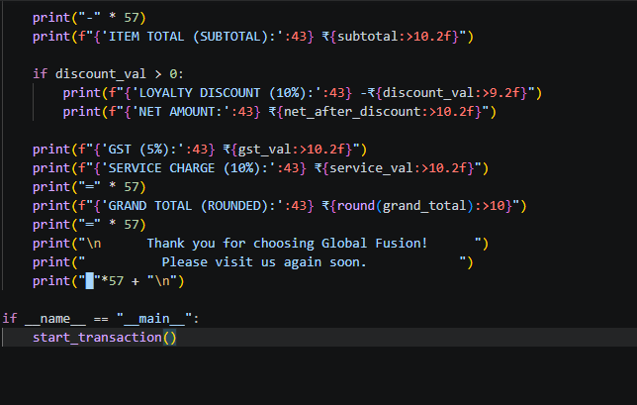
FINAL CODE.

Slide 4
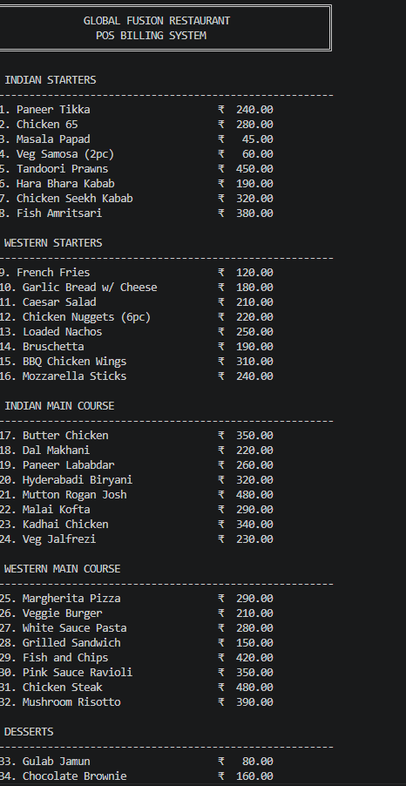
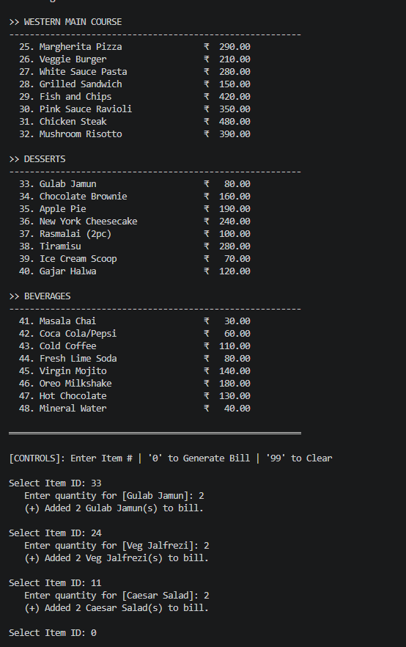
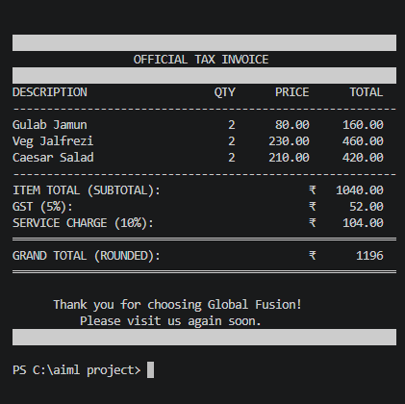
INPUTS AND THE FINAL OUTPUT OF THE CODE

Slide 5
The "Paper-to-Digital" Problem
Revenue Leakage: Identifying how manual math errors lead to significant monthly losses.
Staff Burnout: Reducing the mental load on servers during peak "rush hour" periods.
Paper Waste: Moving away from handwritten KOTs (Kitchen Order Tickets) and bills.
Audit Trails: Solving the problem of untraceable transactions and "missing" cash.
Customer Experience: Eliminating long wait times for final bill generation.

Slide 6
Key Functional Requirements
Multi-Category Navigation: Distinct sections for Indian, Western, and Fusion items.
ID-Based Input: Using unique numerical codes to minimize typing for staff.
Dynamic Cart Logic: Real-time adding, updating, and clearing of ordered items.
Automated Tax Engine: Hardcoded GST and Service Charge rules for compliance.
Loyalty Incentives: Built-in logic to trigger discounts for high-value customers

Slide 7
System Architecture & Data Flow
Modular Design: Separating Menu Data, Transaction Logic, and Invoice Rendering.
Input Layer: Captures User IDs and quantities via the command-line interface.
Validation Layer: Sanitizes inputs to ensure only numbers and valid IDs pass through.
Processing Layer: Calculates row totals and manages the temporary "Session Cart."
Output Layer: Generates a professional, formatted ASCII-based Tax Invoice.

Slide 8
Database Strategy: Nested Dictionaries
Key-Value Pairs: Utilizing Python Dictionaries for high-performance data retrieval.
Categorization: Grouping items logically (e.g., "Indian Main Course") for easier management.
Price Mapping: Floating-point precision for accurate currency representation.
Index Parsing: Splitting keys (e.g., "1. Paneer Tikka") to enable ID-based searching.
Easy Maintenance: Non-technical owners can update prices directly in the script.

Slide 9
The Selection Logic (ID Mapping)
Loop-Search Algorithm: Iterating through nested categories to find specific Item IDs.
String Parsing: Using .startswith() and .split() to identify the correct menu item.
Return Values: Returning both the item name and unit price for calculation.
Null Handling: Returning None if an ID is not found, preventing system crashes.
Speed: Instantaneous lookup even with a menu of 100+ items.
s

Slide 10

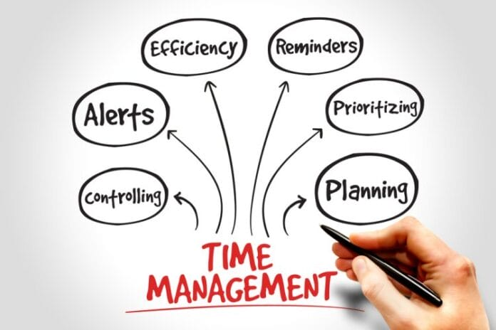
Real-Time Transaction Management
The "Cart" Object: A dynamic list that stores dictionaries of active orders.
Duplicate Detection: Scanning the cart to see if an item already exists.
Quantity Accumulation: Adding new quantities to existing items rather than duplicating lines.
Auto-Totaling: Recalculating the row total whenever a quantity change occurs.
Session Isolation: Each transaction is fresh, ensuring no data bleed between tables.

Slide 11

User Interface Design (CLI Aesthetics)
Visual Framing: Using double-line borders (═) for a premium "bill" look.
Column Alignment: Using f-string padding (:28) to create a perfectly aligned table.
Emphasis: Bolding and capitalizing headers to guide the user's eye.
Currency Symbols: Integrating the "₹" symbol for localized financial clarity.
Action Cues: Clear prompts like [CONTROLS]: Enter Item # for staff guidance.

Slide 12
Financial Logic – Subtotal & Discounts
Base Summation: Aggregating all row totals into a single "Subtotal" variable.
Threshold Logic: Checking if the bill exceeds the ₹2,000 "Loyalty" limit.
Rate Application: Calculating the 10% discount value based on the subtotal.
Net Amount: Subtracting the discount before tax application to ensure fairness.
Transparency: Showing the discount as a negative line item on the final receipt

Slide 13
Final tips & takeaways
Service Charge: Applying a 10% hospitality fee to the net amount.
The Formula: $Grand Total = Net + (Net \times 0.05) + (Net \times 0.10)$.
Financial Accuracy: Using 2-decimal point precision for all intermediate math.
GST Calculation: Applying a fixed 5% tax on the net (after-discount) amount.
Rounding: Using the round() function for the final payment amount.
.

Slide 14
Error Handling & Robustness
Integer Casting: Using try...except to catch errors when text is entered instead of numbers.
Quantity Guards: Ensuring quantities are positive integers (cannot order -1 items).
Range Checks: Validating that IDs fall strictly between 1 and 48.
Safe Exit: Providing a dedicated command ('0') to finish the transaction safely.
Cart Wipe: Allowing '99' to clear all mistakes instantly without restarting the app.

Slide 15
Technical Deep Dive: The Loop Engine
Infinite Loop Pattern: Using while True to maintain the interactive POS session.
Break Conditions: Terminating the loop only when the "Generate Bill" signal is received.
State Management: Variables are updated in-memory for zero-latency performance.
Interactive Input: The input() function pauses the engine to wait for staff action.
Flow Control: Using continue to skip invalid logic and keep the app running.
.

Slide 16
the Output: Anatomy of a Tax Invoice
Branding Header: A high-impact blockquote section for restaurant identity.
Itemized Rows: Detailed breakdown of Description, Qty, Price, and Total.
Separator Lines: Using dashed lines to distinguish between order list and totals.
Financial Summary: Clear display of Subtotal, Net, GST, and Service Charge.
Call to Action: A friendly footer message to encourage repeat visits.

Slide 17
Performance & Efficiency
Zero Dependencies: Runs on standard Python libraries with no external installs.
Low RAM Usage: The entire system consumes less than 20MB of memory.
Fast Execution: Capable of processing hundreds of orders per second.
Cross-Platform: Works seamlessly on Windows, macOS, and Linux terminals.
Portable Code: A single .py file that can be shared or moved easily.

Slide 18
UX Considerations for Staff
Minimal Cognitive Load: No need to memorize prices; only menu numbers.
Confirmation Feedback: Immediate "Added" messages prevent double-entry errors.
Logical Categories: Grouping items by cuisine type matches the flow of a typical meal.
No Mouse Required: 100% keyboard-driven for maximum speed during busy hours.
Large Totals: Final Grand Total is the most prominent part of the output.

Slide 19
Summary & Final Impact
Scalable Solution: Can grow from a single-counter cafe to a busy restaurant.
Operational Control: Gives management full visibility over pricing and taxes.
Modernization: Elevates the restaurant's image through professional billing.
Profitability: Directly improves the bottom line by eliminating manual errors.
Open Floor: Inviting questions on the code structure or implementation

Slide 20
Thank you
PANCHAMI CHAKRABORTY
panchami.25bai10587@vitbhopal.ac.in

